Slide 1
NLH update 04/20/23

Slide 2
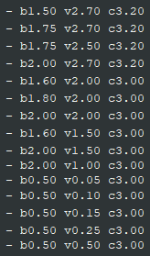
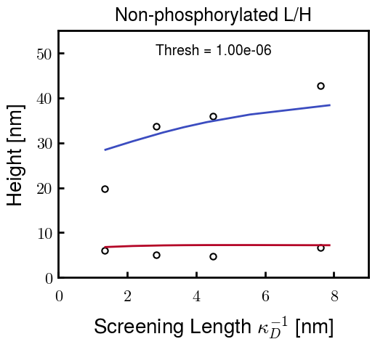


Brute force approach—Pure NFL/NFH
Choose parameters for NFL and NFH independently
NFL Possibilities
NFH Possibilities
For example,
b: Kuhn length
v: Monomer volume
c: Flory Huggins parameter for
most hydrophobic residues

Slide 3
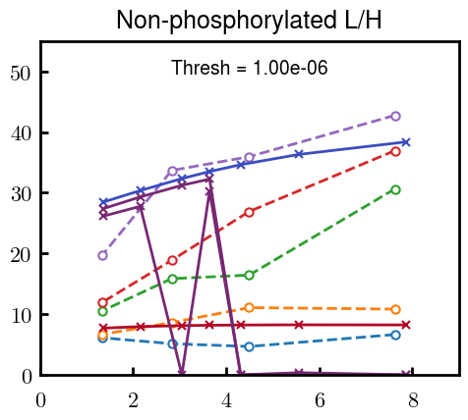
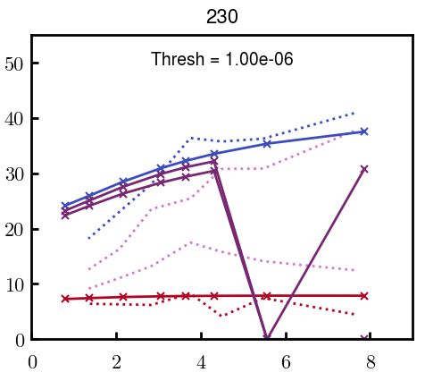
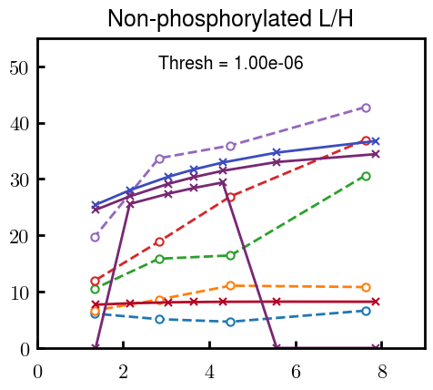
Brute force approach—Blended NFL/NFH
Some examples at L100, L80, L30, L00; ignore points with H = 0
Even with many curves that look good for the pure cases, the height profiles are consistently very non-linear with respect to L composition (from top to bottom), especially from 0% L to 30% L
Experimental heights look more or less linear with respect to NFL addition

Slide 4
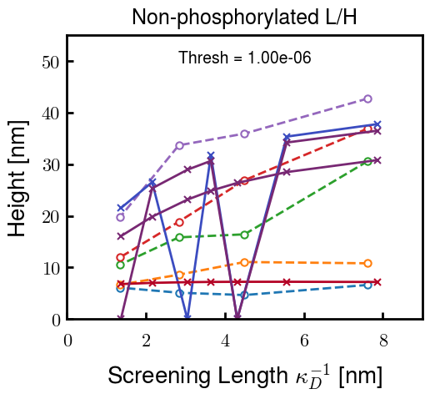
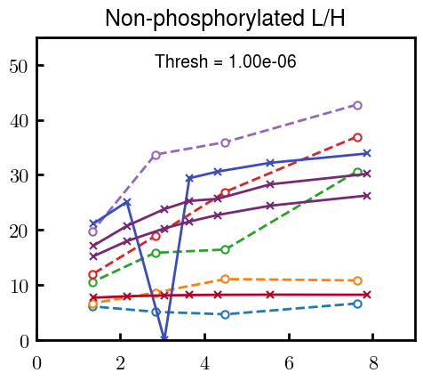
Height can be tuned using NFL parameters, but only so much
2 examples using different parameters for NFH but not NFL

Slide 5
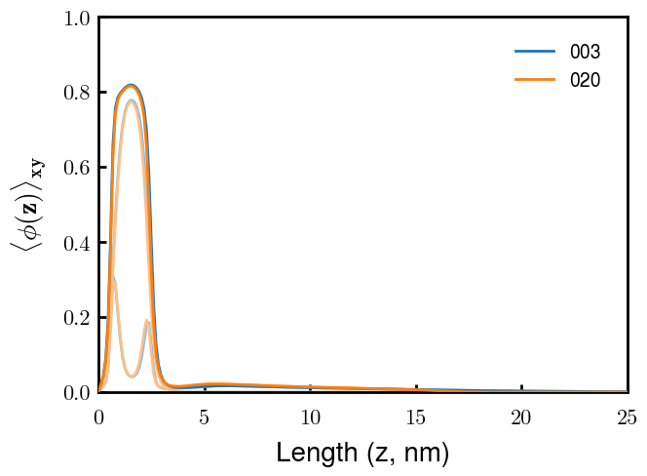
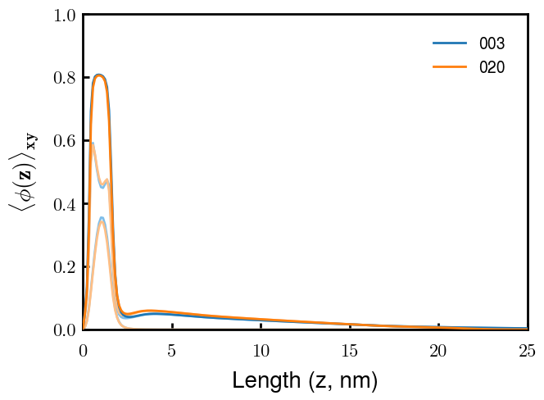
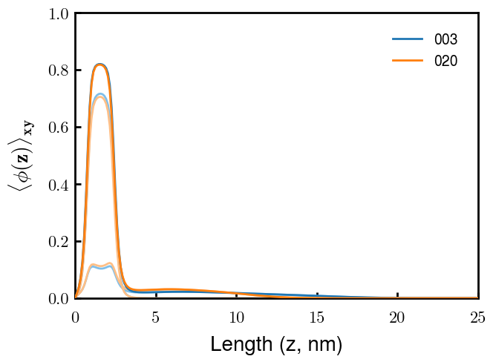
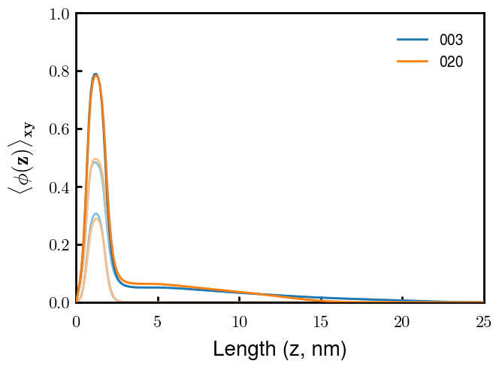
Crowding of the inner layer expels NFL even at low mol %
L30 / H70
L80 / H20
H
L
L
H
2 examples using different parameters for NFH but not NFL
H
L
L
H
We expect a linear response wrt adding more NFL. This means that there should be no/very few chains of L that escape into the dilute, outer layer
By decreasing the volume of NFH, we should be able to reduce the crowding at the inner layer. With less crowding, fewer NFL should hopefully be expelled

Slide 6
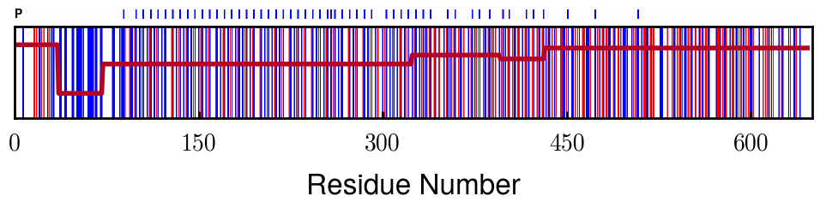
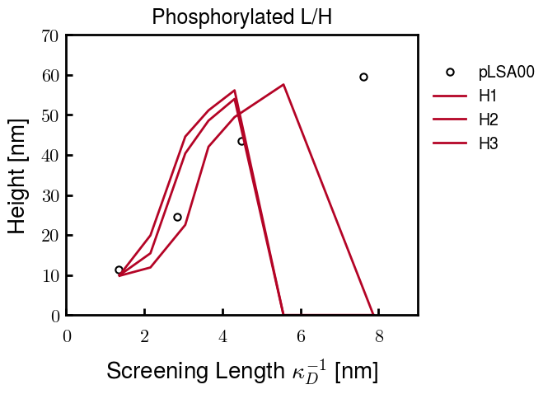
Phosphorylated NFH Progress
phosph. = - 1.5 e
Currently running one more to get a closer fit; if not, the current best one should be close enough
These parameters are close to those of the native NFH. Hopefully means that I can use the final parameters of native NFL to get the blended phosph. results
Trials
Quick note: the points that go to zero just didn’t converge. The point at 6 nm takes a really long time to converge, so I will probably proceed with only calculating from 1 to 6 nm.
In the future, if needed, I can go to 8 nm (1.6 mM)

Slide 7
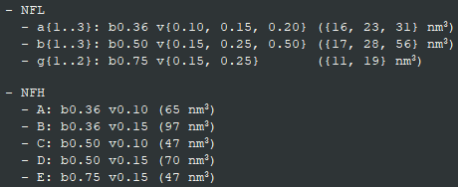
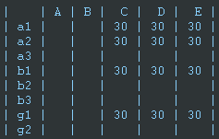

Matrix Approach: Classify behavior and incr./decr. volumes as necessary
H Vol decrease (by v)
H Vol decrease (by b)
C
D
E
L Total Vol decrease
a2
a1
L b decrease
b1
g1

Slide 8
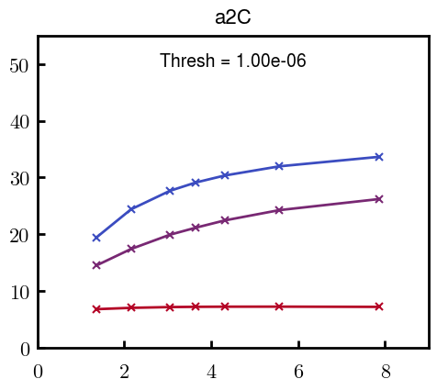
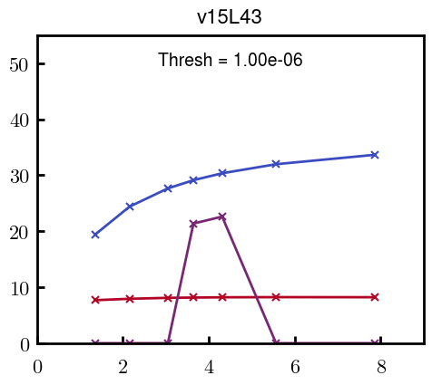
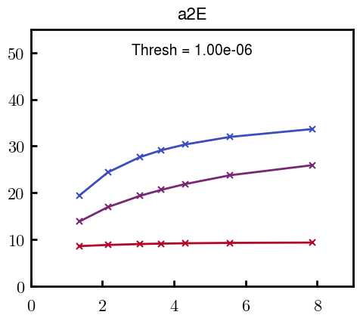
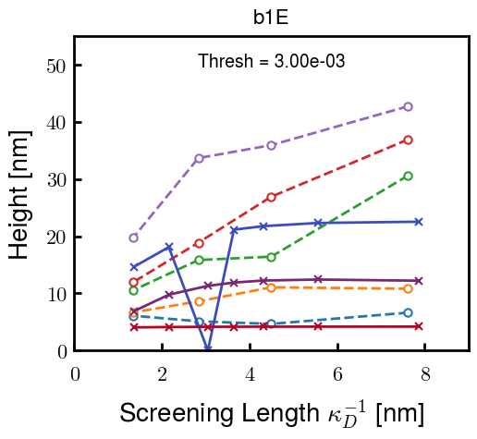
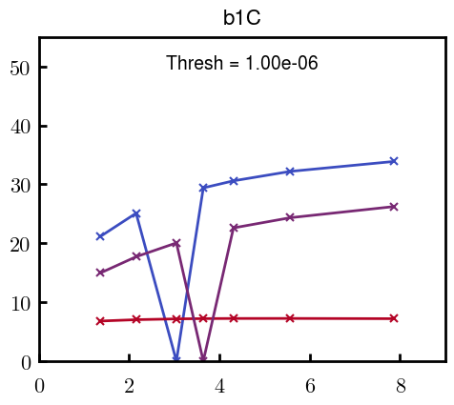
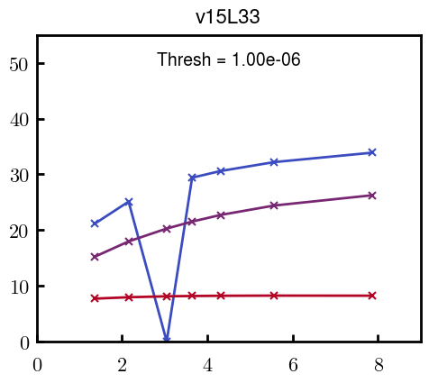
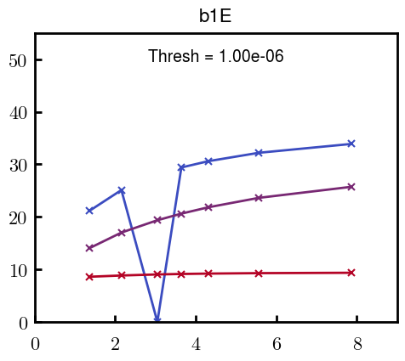
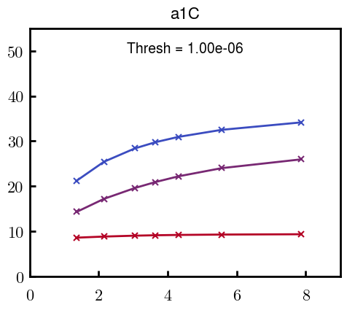
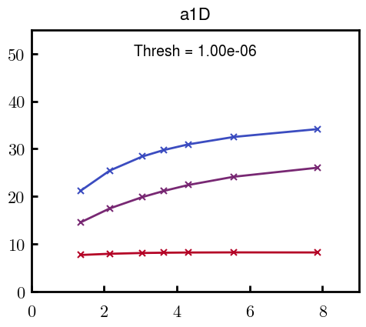

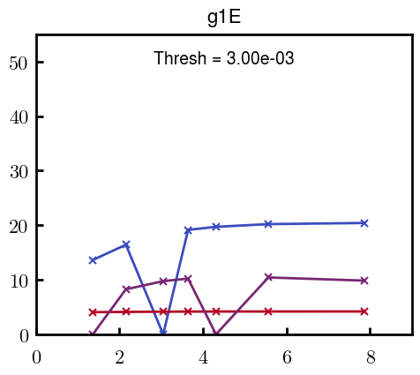
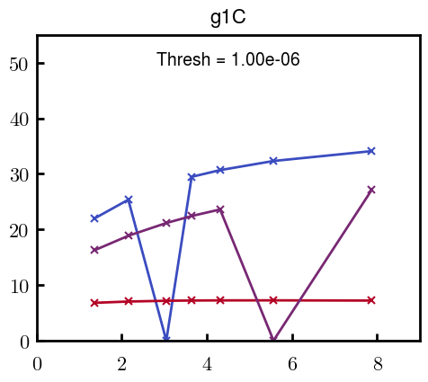

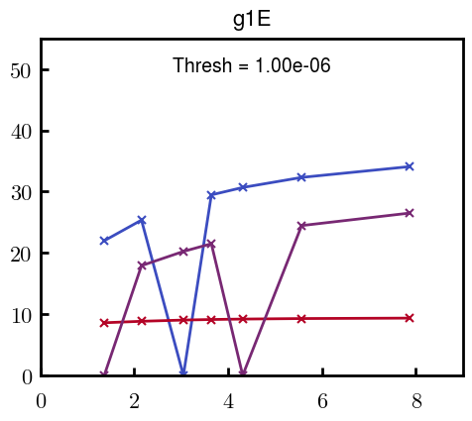
H Vol decrease (by v)
H Vol decrease (by b)
Desired “linearity” by tuning H thresh based on polymer density of expelled NFL
L Vol decrease (by b)
Comes at severe cost of overall height. Try to minimize outer concentration to approach pure thresh of 1e-06

Slide 9
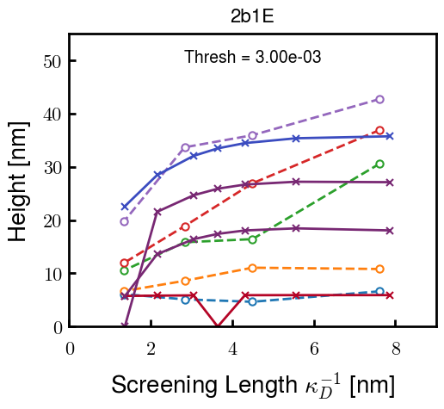
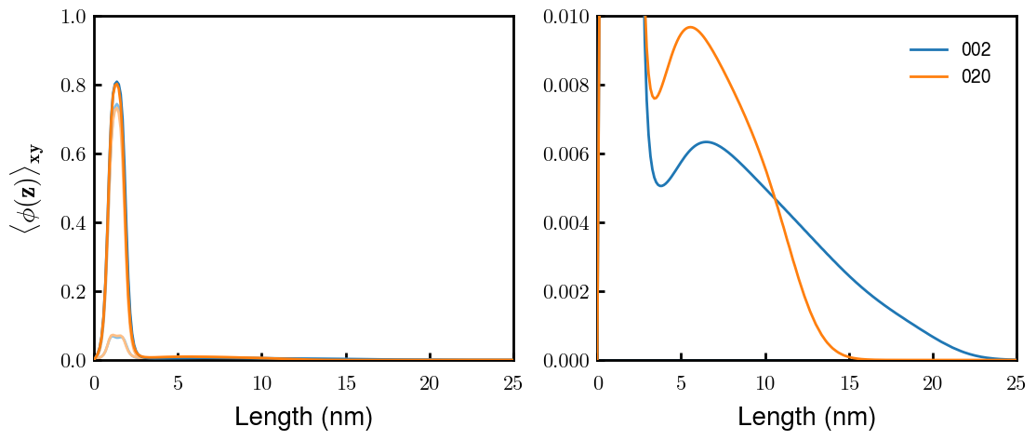
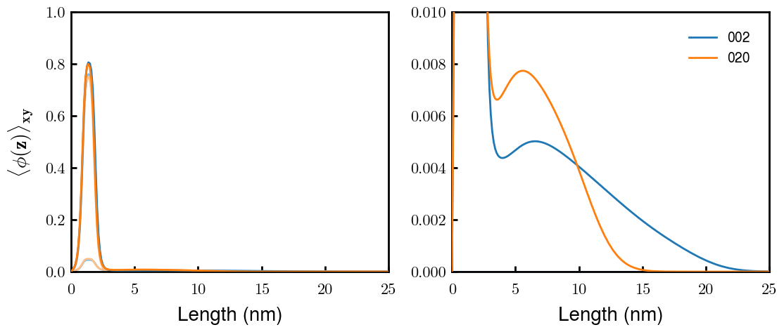
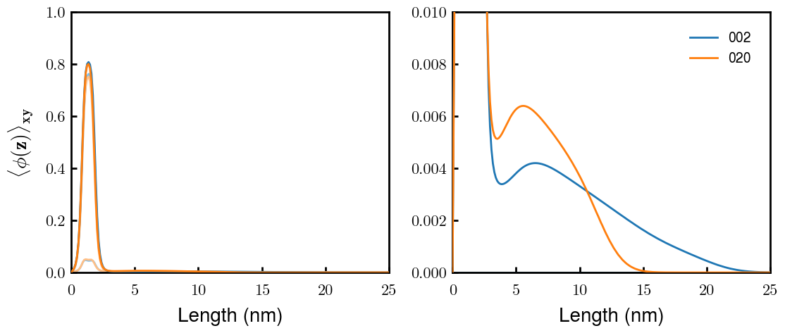
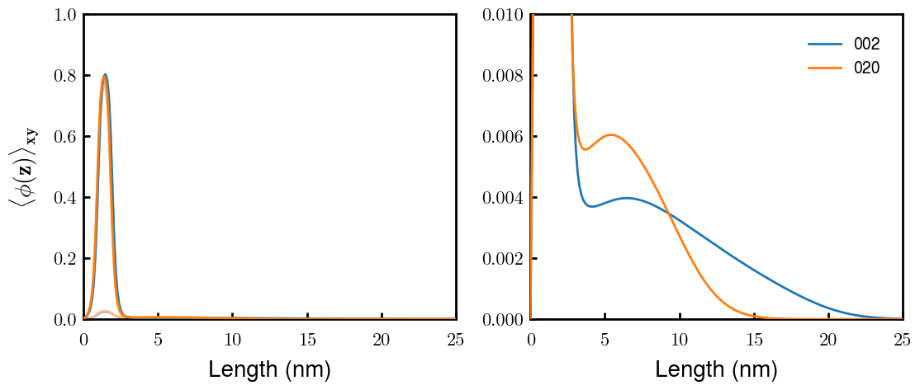
a2C_30
Scaling factor:
Arbitrary scaling of calculated heights (e.g. c * H_{theory})
Not easy to justify; can just as well say that theory is wrong and insight is not useful
Scaled by 1.6
b1C_30
a1C_30
Dilute layer is extremely dilute (0.01 vs. 0.80 in condensed layer)
In other results (e.g. profiles for pure brushes or other literature), dilute can be approx. 0.1
These profiles were optimized to get as close to linear behavior as possible
However, they both get less “realistic” and final heights still do not match expts
g1C_30

Slide 10
Takeaways
Polymer density profiles for the pure brushes are obtainable using theory
Fitting parameters: b, v, chi, H thresh
Many parameter sets can recover experimental heights
In the L/H mixture, the calc. height profiles were very non-linear wrt addition of any L.
Caused by L being pushed out (sterically and electrostatically) by H
To recover linear response, density profiles became non-physical and heights did not match experiments quantitatively
Possible reasons
Changes are not happening only in 1D (patterning or organization inside of the condensed layers)
Height from polymer density profiles is not a sufficient proxy for AFM-calculated height
Mechanical properties of L/H or dilute/condensed layers are not similar
Theory can also calculate force-spectra, but is not high-throughput
Some other interactions between L/H that are not considered in our model (weak polyacid/base, local polarization, hydrogen-bonding, etc.)

Slide 11
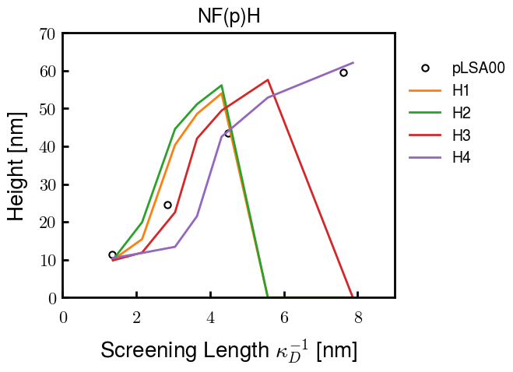
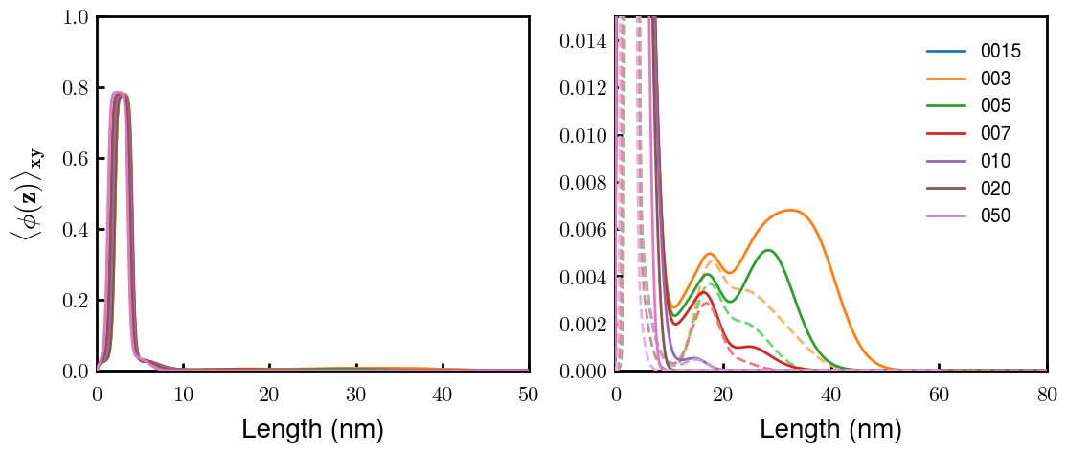
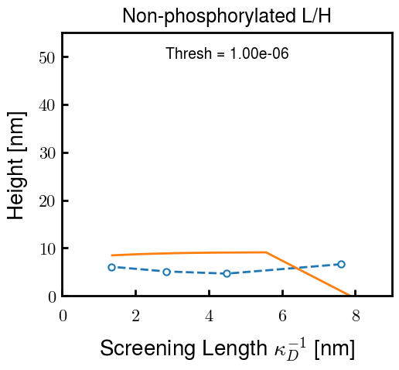
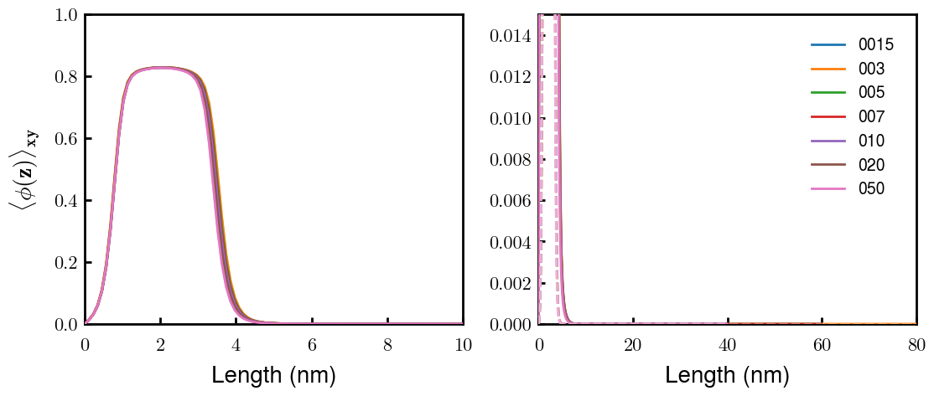
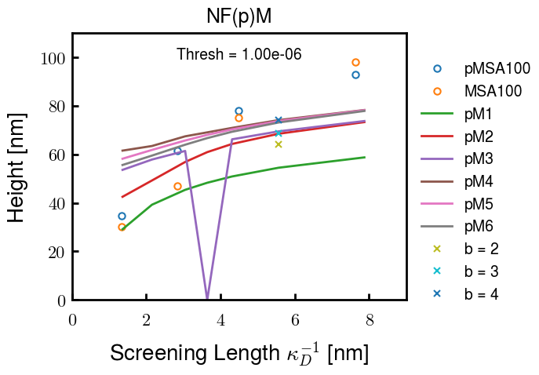
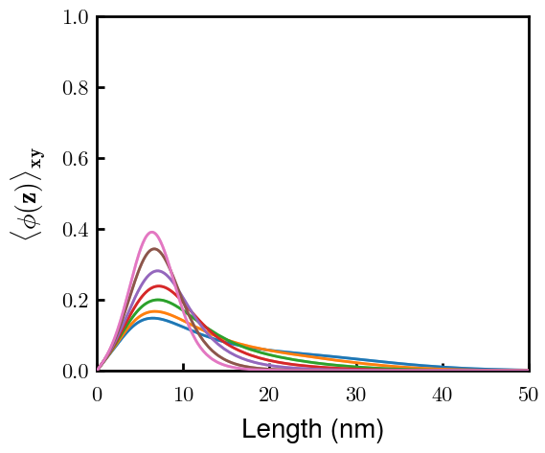
05/12/23
pH3
H3
pM2

